Slide 1


UNIFORM GUIDE
Ivy Classical Academy
Uniform Guide
Except shoes, all required uniform items must be purchased through our school’s uniform store on the French Toast website:
​Ivy Classical Academy Uniform Store
When selecting sizes, please remember that your children are growing!
French Toast has a great tool to find the correct sizing for your child’s needs:
https://www.frenchtoast.com/size-chart

Slide 2
UNIFORM GUIDE
Please note the following items are discontinued
Solid colored boys and girls ties
Khaki skirts
Solid blue jumpers
New uniform items:
Plaid Box Pleat Jumper (kinder-2nd grade only)
Boys V-Neck Sweater Vest
Performance Quarter Zip Pullover
Upper School P.E. uniforms
Shirts, shorts, sweat top,& bottom
Long Sleeve Fitted Oxford Shirt

Slide 3
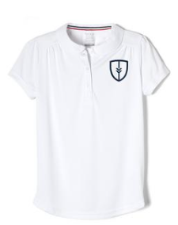
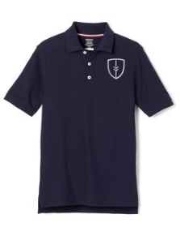
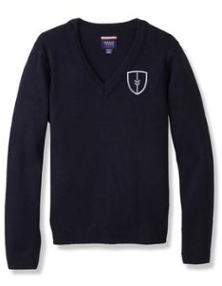
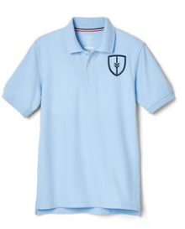
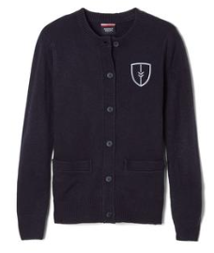
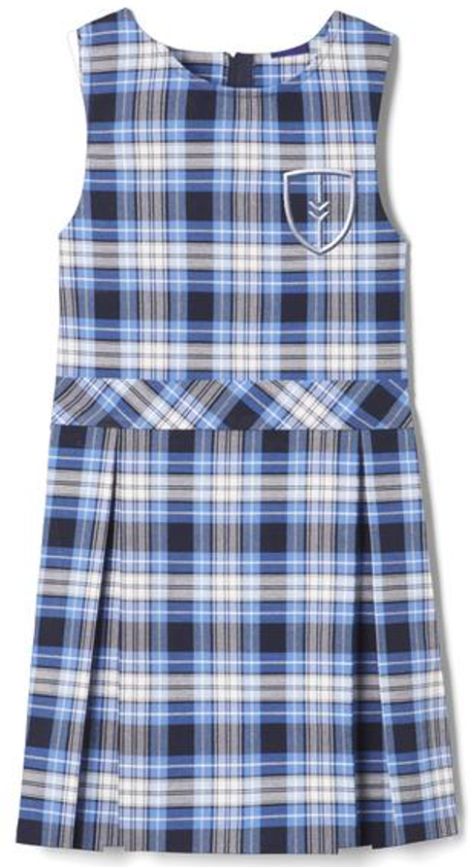
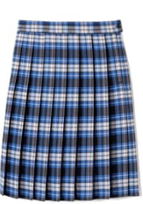
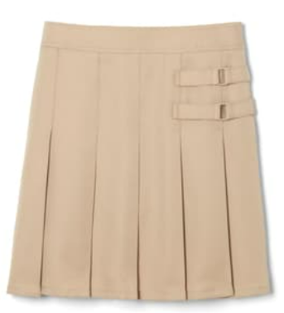
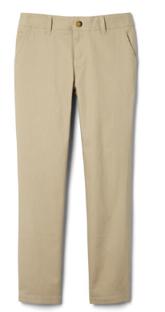
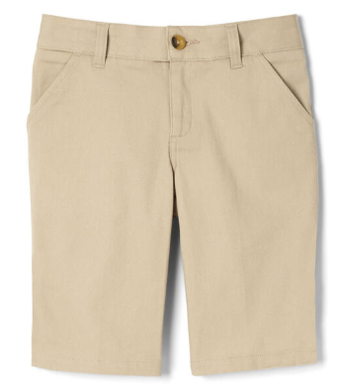
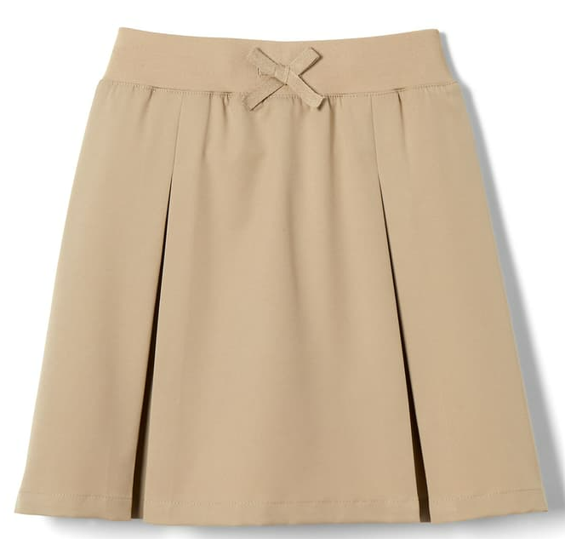
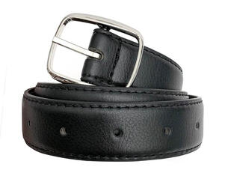
Plaid Box Pleat Jumper
Item # 1687
UNIFORM GUIDE
K – 2 GIRLS DAILY
Required:
Optional:
Peter Pan Polo
#1700 white
Polo Shirt
#1012 or 1629
navy or blue
Crewneck Sweater Cardigan
#1371 navy
V-Neck Pullover Sweater
#1731 navy
At The Knee Pleated Skirt
# 1065 clear blue plaid
Pleated Two-Tab Skort
# 1302 khaki
Girls’ Stretch Twill Bermuda Short
#1692 khaki
Belt
*any vendor – black
Girls’ Straight Fit Stretch Twill Pant
#1573 khaki
Pull-on Kick Pleat Performance Skort
# 1703 khaki

Slide 4
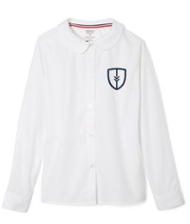
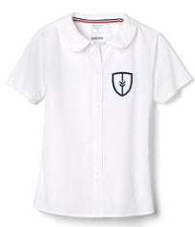
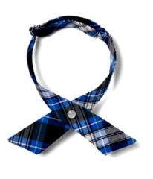

UNIFORM GUIDE
K – 2 GIRLS FORMAL
Required:
Optional:
Belt
*any vendor – black
Peter Pan Collar Blouse- white
#1594 long sleeve or
#1593 short sleeve
Crewneck Sweater Cardigan
#1371 navy
V-Neck Pullover Sweater
#1731 navy
At The Knee Pleated Skirt
# 1065 clear blue plaid
Cross Tie
#10754 clear blue plaid
Plaid Box Pleat Jumper
Item # 1687
Pleated Two-Tab Skort
# 1302 khaki
Girls’ Stretch Twill Bermuda Short
#1692 khaki
Pull-on Kick Pleat Performance Skort
# 1703 khaki
Girls’ Straight Fit Stretch Twill Pant
#1573 khaki

Slide 5
UNIFORM GUIDE
3RD – 5th GIRLS DAILY
Required:
Optional:
Crewneck Sweater Cardigan
#1371 navy
V-Neck Pullover Sweater
#1731 navy
Polo Shirt
#1012 or 1629
navy or blue
Pull-on Kick Pleat Performance Skort
# 1703 khaki
Belt
*any vendor – black
At The Knee Pleated Skirt
# 1065 clear blue plaid
Pleated Two-Tab Skort
# 1302 khaki
Girls’ Stretch Twill Bermuda Short
#1692 khaki
Girls’ Straight Fit Stretch Twill Pant
#1573 khaki

Slide 6
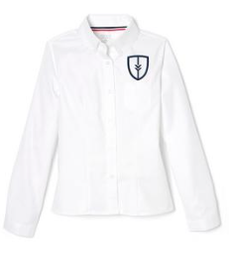
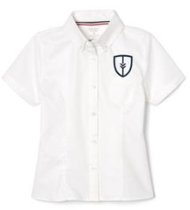
UNIFORM GUIDE
3rd - 5th GIRLS FORMAL
Required:
Optional:
Belt
*any vendor – black
Crewneck Sweater Cardigan
#1371 navy
V-Neck Pullover Sweater
#1731 navy
Fitted Oxford Shirt - white
#1706 long sleeve or #1707 short sleeve
Pull-on Kick Pleat Performance Skort
# 1703 khaki
Cross Tie
#10754 clear blue plaid
At The Knee Pleated Skirt
# 1065 clear blue plaid
Girls’ Stretch Twill Bermuda Short
#1692 khaki
Pleated Two-Tab Skort
# 1302 khaki
Girls’ Straight Fit Stretch Twill Pant
#1573 khaki

Slide 7
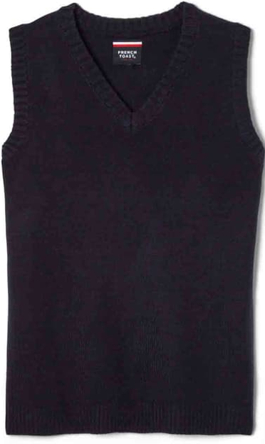

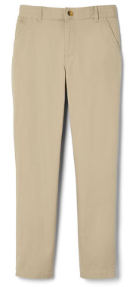
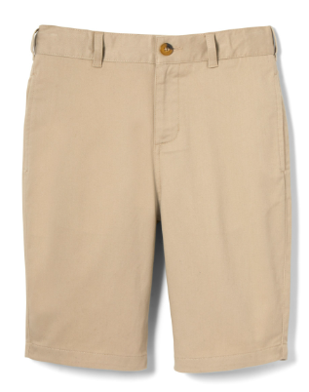
UNIFORM GUIDE
K – 5th BOYS DAILY
Required:
Optional:
Polo Shirt
#1012 or #1629
navy or blue
V-Neck Pullover Sweater
#1731 navy
V-Neck Sweater Vest
#1029 navy
Belt
*any vendor – black
Boys’ Straight Fit Stretch Twill Pant
#1694 khaki
Boys’ Flat Front Stretch Twill Short
#1699 khaki

Slide 8
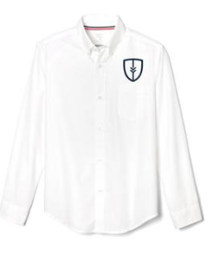
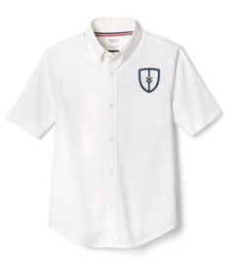

UNIFORM GUIDE
K – 5th BOYS FORMAL
Required:
Optional:
Oxford Shirt - white
#1017 long sleeve or #1020 short sleeve
V-Neck Sweater Vest
#1029 navy
V-Neck Pullover Sweater
#1731 navy
Belt
*any vendor – black
Tie
#1030 clear blue plaid
Boys’ Straight Fit Stretch Twill Pant
#1694 khaki
Boys’ Flat Front Stretch Twill Short
#1699 khaki

Slide 9
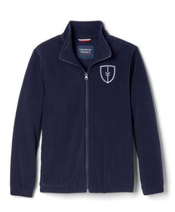
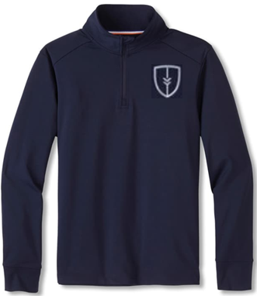
UNIFORM GUIDE
OUTERWEAR
Performance Quarter Zip Pullover
#1725 navy
Full Zip Fleece
#1689 navy

Slide 10
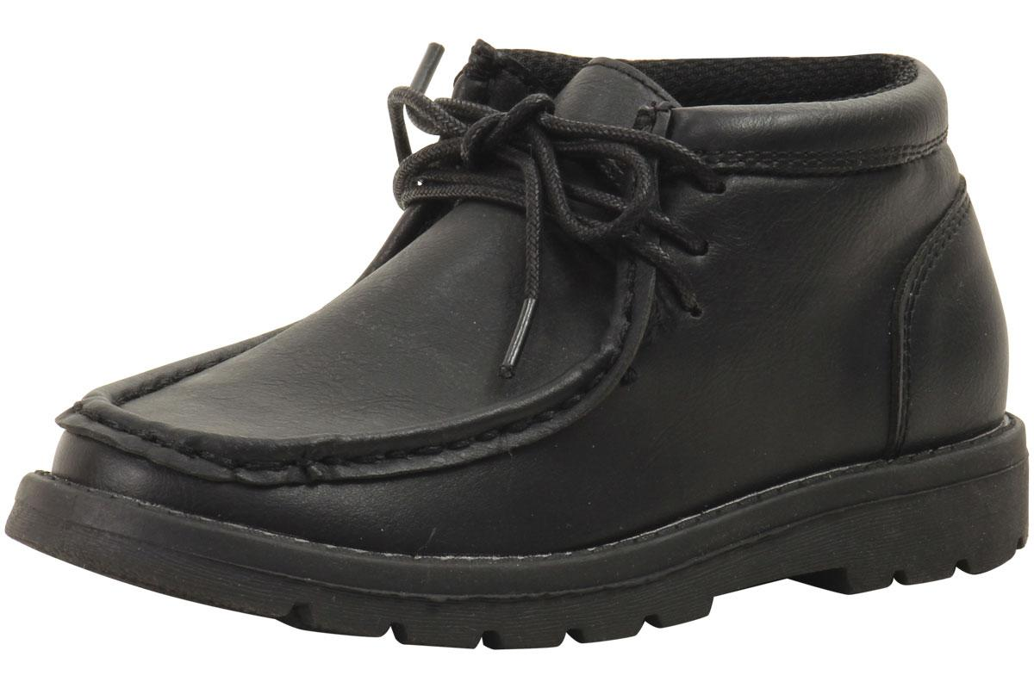
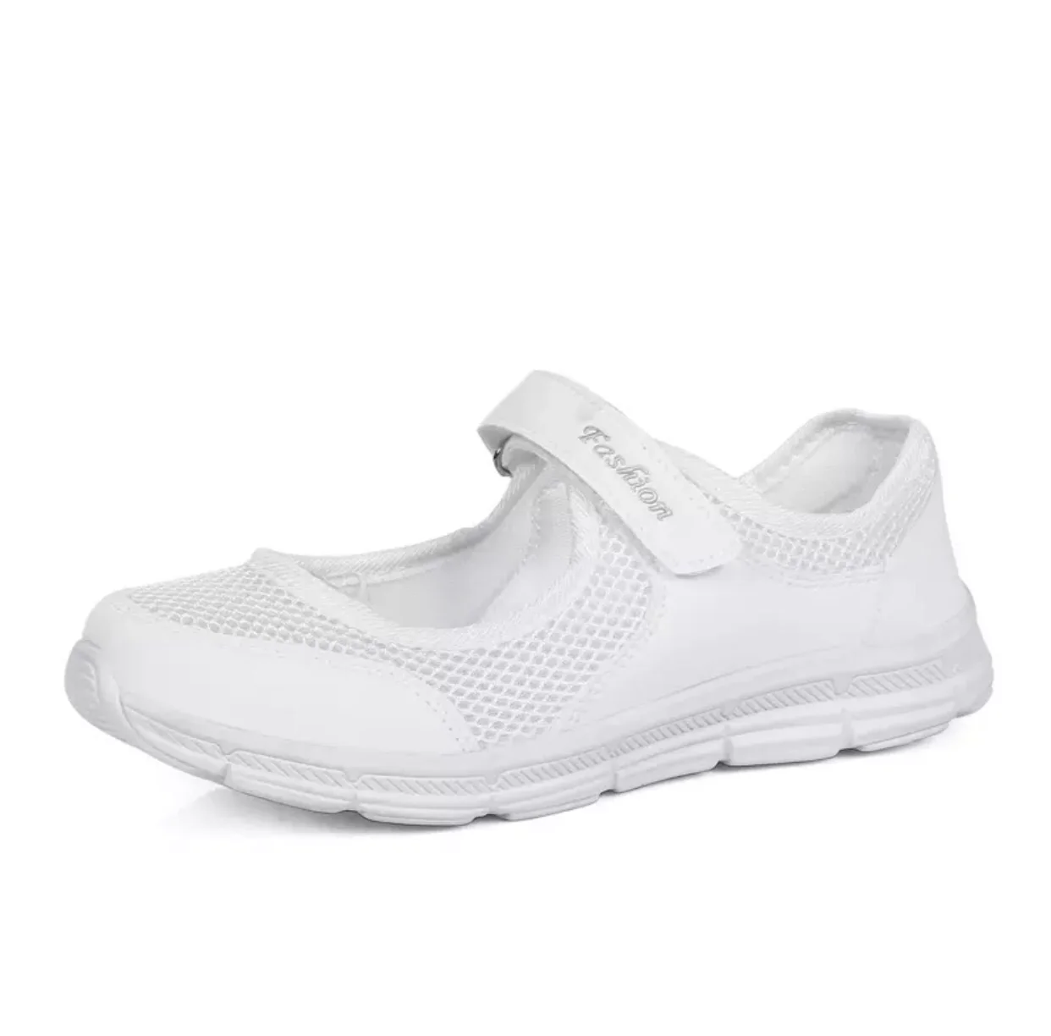
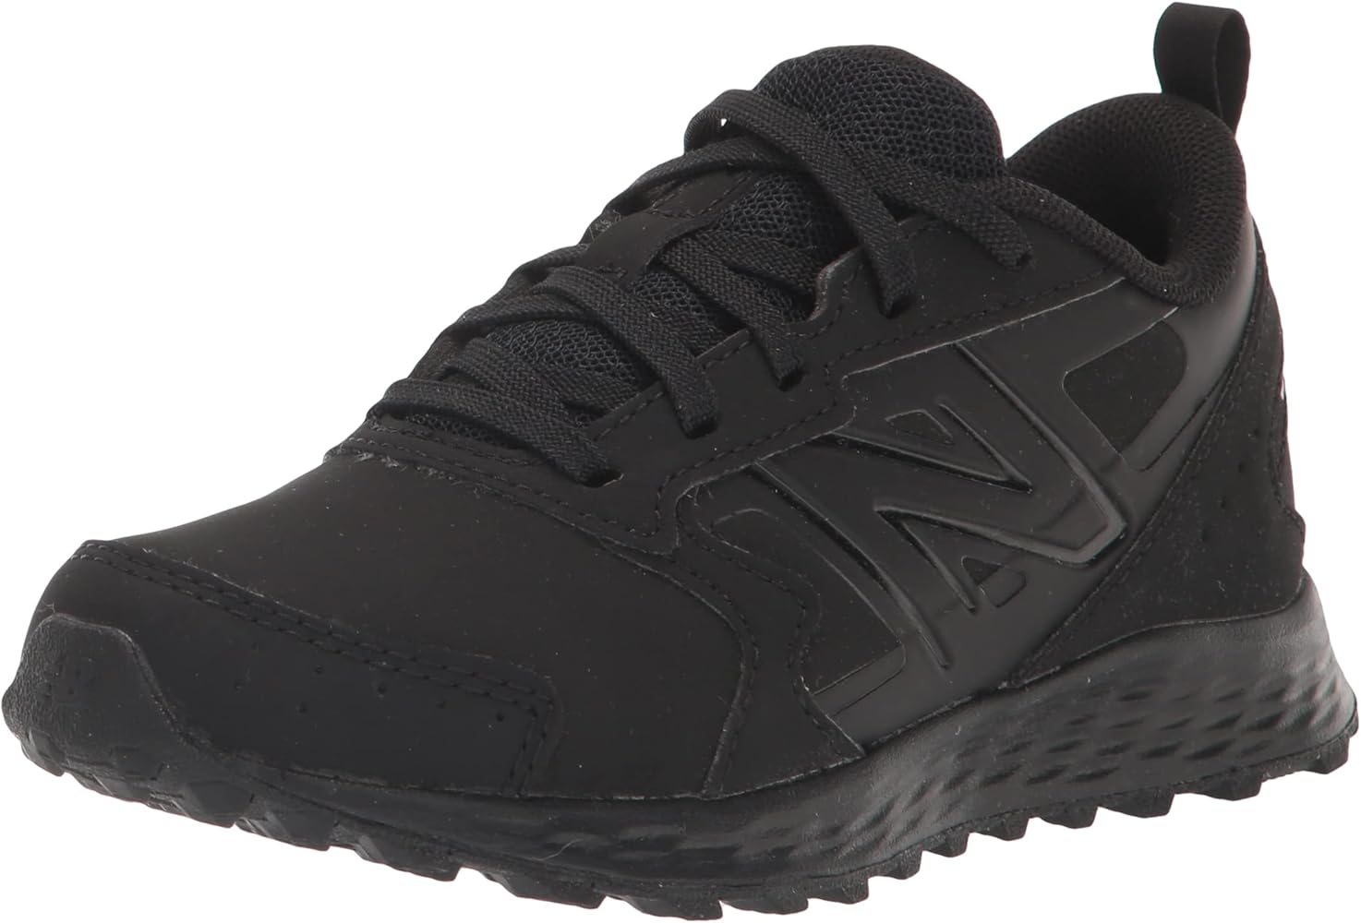
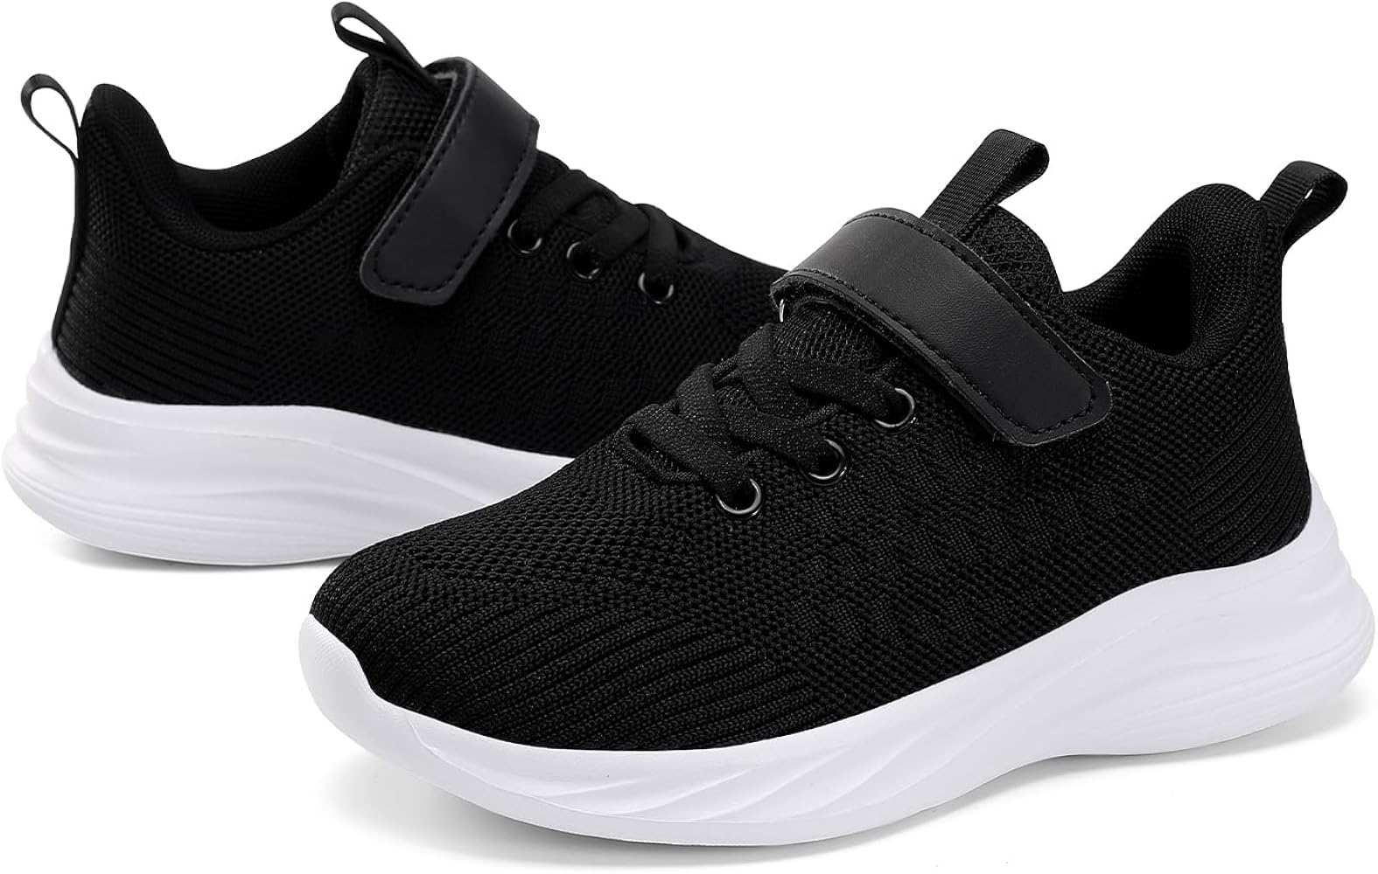
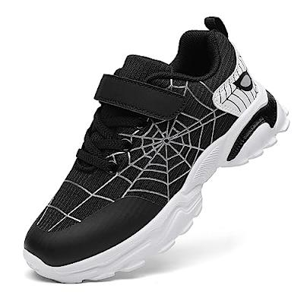
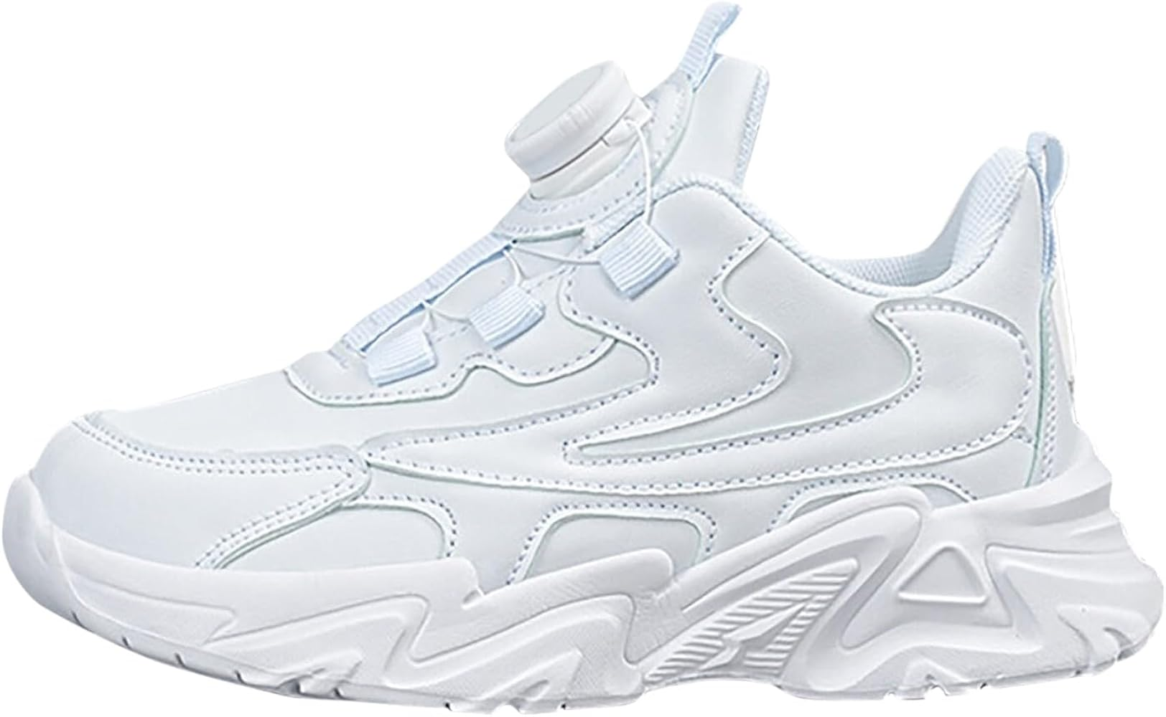
UNIFORM GUIDE
SOCKS & SHOES
K-6th Shoes Requirements
Must be all white or all black. Athletic shoes only in grades K-5th. 6th may wear dress shoes, but must have athletic shoes to wear for PE. Brands are not specified. Any style white, black or navy socks are permitted.
Acceptable
Not accepted:
Boots, dress shoes (K-5th), black & white

Slide 11
UNIFORM GUIDE
GIRLS’ UNIFORM GUIDANCE
Uniform Guidance
K-7th
Additional uniform guidance may be found on pages 15-17 of the Ivy Classical Academy Family Handbook.

Slide 12
UNIFORM GUIDE
The following pages contain uniform items that are for Upper School Students only.

Slide 13
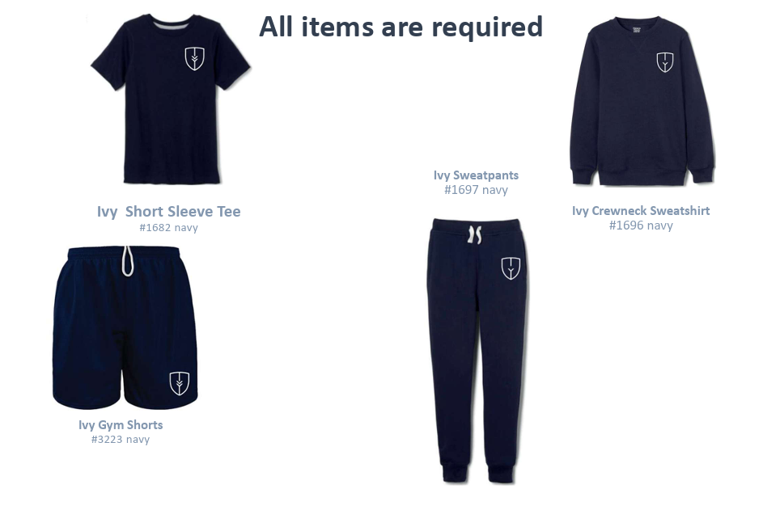
UNIFORM GUIDE PHYSICAL EDUCATION UNIFORMS

Slide 14
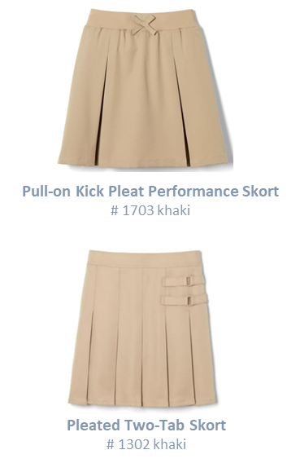
UNIFORM GUIDE UPPER SCHOOL GIRLS DAILY
2025/2026 UNIFORM GUIDE 6th GIRLS DAILY
Required:
Optional:
Polo Shirt
#1012 or 1629
navy or blue
Crewneck Sweater Cardigan
#1371 navy
V-Neck Pullover Sweater
#1731 navy
Belt
*any vendor – black
At The Knee Pleated Skirt
# 1065 clear blue plaid
Girls’ Stretch Twill Bermuda Short
#1692 khaki
Girls’ Straight Fit Stretch Twill Pant
#1573 khaki

Slide 15
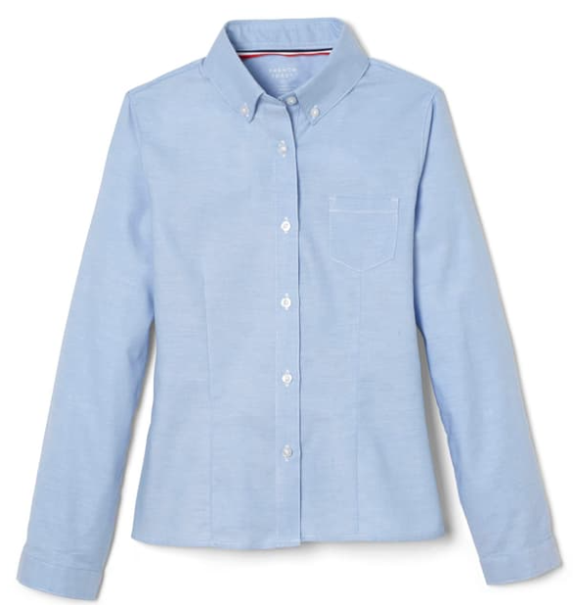

2025/2026 UNIFORM GUIDE 6th GIRLS FORMAL
UNIFORM GUIDE UPPER SCHOOL GIRLS FORMAL
Required:
Optional:
Pleated Two-Tab Skort
# 1302 khaki
Long Sleeve Fitted Oxford Shirt (Feminine Fit)
#1706 blue
Crewneck Sweater Cardigan
#1371 navy
V-Neck Pullover Sweater
#1731 navy
Fitted Oxford Shirt - white
#1706 long sleeve or #1707 short sleeve
Belt
*any vendor – black
Cross Tie
#10754 clear blue plaid
At The Knee Pleated Skirt
# 1065 clear blue plaid
Pull-on Kick Pleat Performance Skort
# 1703 khaki
Girls’ Stretch Twill Bermuda Short
#1692 khaki
Girls’ Straight Fit Stretch Twill Pant
#1573 khaki

Slide 16
2025/2026 UNIFORM GUIDE
6th BOYS DAILY
UNIFORM GUIDE UPPER SCHOOL BOYS DAILY
Required:
Optional:
Polo Shirt
#1012 or #1629
navy or blue
V-Neck Sweater Vest
#1029 navy
V-Neck Pullover Sweater
#1731 navy
Belt
*any vendor – black
Boys’ Straight Fit Stretch Twill Pant
#1694 khaki
Boys’ Flat Front Stretch Twill Short
#1699 khaki

Slide 17
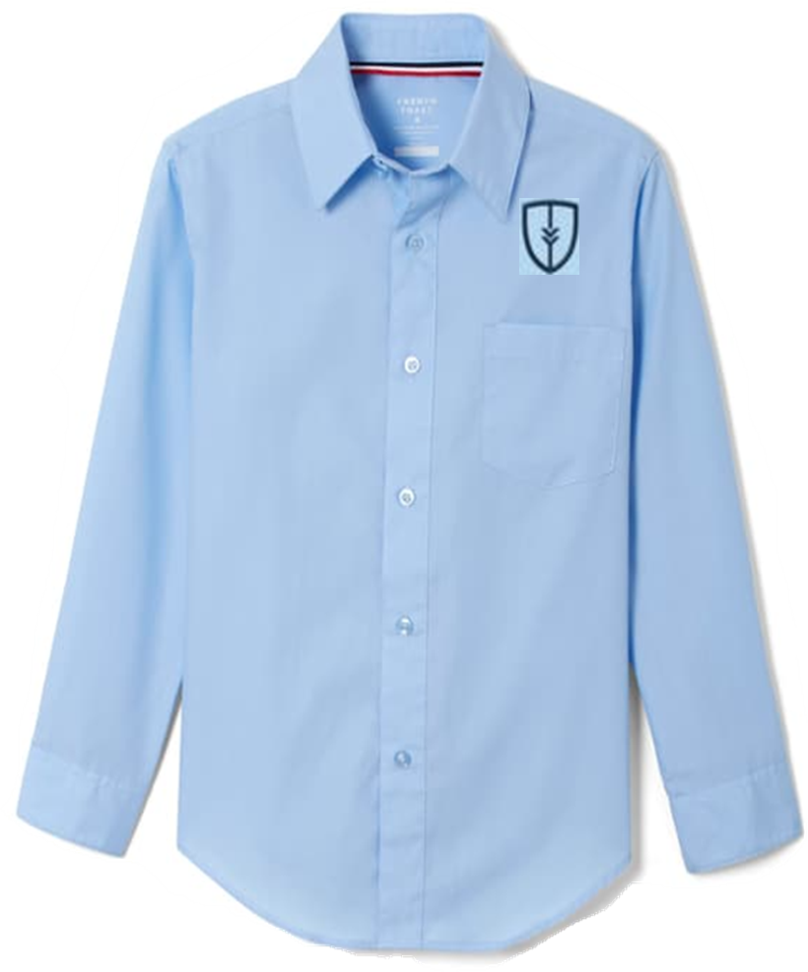
2025/2026 UNIFORM GUIDE
6th BOYS FORMAL
UNIFORM GUIDE UPPER SCHOOL BOYS DAILY
Required:
Optional:
Oxford Shirt - white
#1017 long sleeve or #1020 short sleeve
Long Sleeve Fitted Oxford Shirt #1017
V-Neck Pullover Sweater
#1731 navy
Belt
*any vendor – black
Tie
#1030 clear blue plaid
Boys’ Straight Fit Stretch Twill Pant
#1694 khaki
V-Neck Sweater Vest
#1029 navy
Boys’ Flat Front Stretch Twill Short
#1699 khaki

