Slide 1


UNIFORM GUIDE
Ivy Classical Academy
Uniform Guide
Except shoes, all required uniform items must be purchased through our school’s uniform store on the French Toast website:
​Ivy Classical Academy Uniform Store
When selecting sizes, please remember that your children are growing!
French Toast has a great tool to find the correct sizing for your child’s needs:
https://www.frenchtoast.com/size-chart

Slide 2
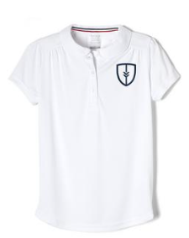
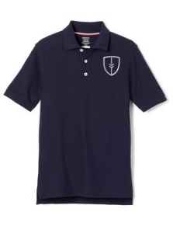
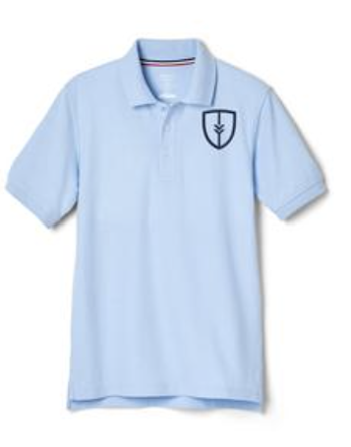
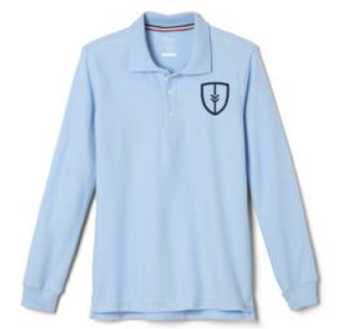
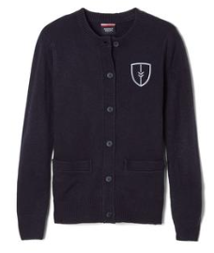
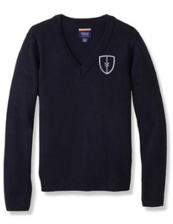
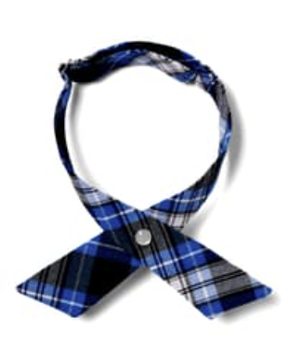
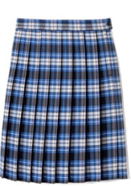
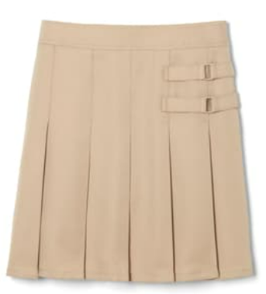
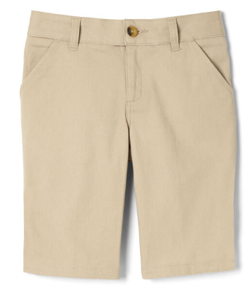
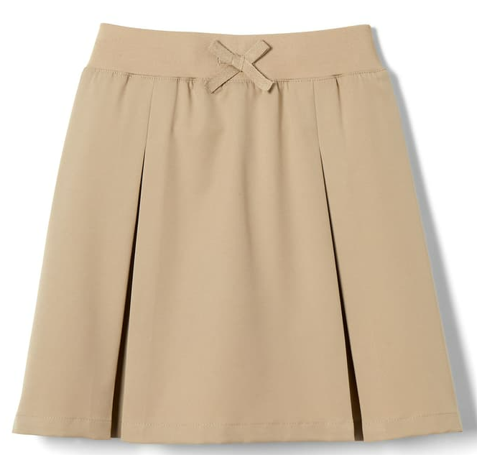
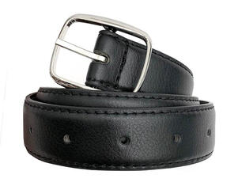
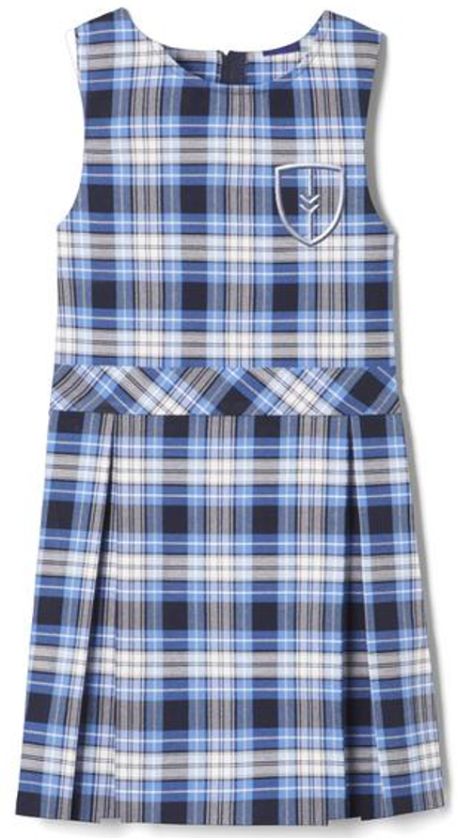
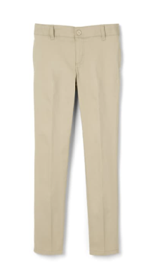
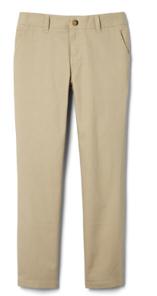
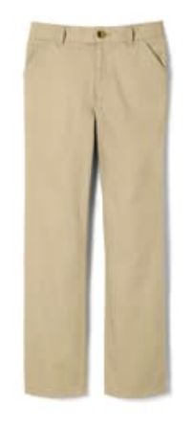
Plaid Box Pleat Jumper
Item # 1687
UNIFORM GUIDE
K - 2nd GIRLS DAILY
Peter Pan Polo
#1700 white
Performance Polo Shirt
#1629
navy or blue
Pique Polo Shirt
#1012
navy or blue
Long Sleeve Pique Polo
#1009
navy or blue
Crewneck Sweater Cardigan
#1371 navy
V-Neck Pullover Sweater
#1731 navy
Adjustable Cross Tie
#10754 or #10744
At The Knee Pleated Skirt
# 1065 clear blue plaid
Pleated Two-Tab Skort
# 1703 khaki #1397 Plaid
Girls’ Stretch Twill Bermuda Short
#1692 khaki
Pleated Two-Tab Skort
# 1302 khaki
Black Belt
*any vendor
Girls’ Slim Fit Stretch Twill Pant
#1417 khaki
Girls’ Straight Fit Stretch Twill Pant
#1573 khaki
Girls’ Pull-On Fitch Stretch Twill Pant
#1693 khaki

Slide 3
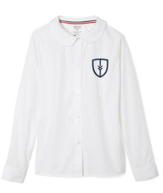
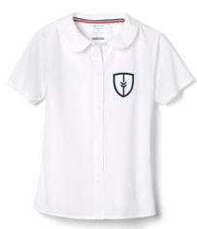
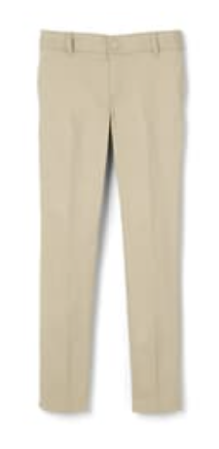

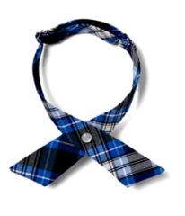
UNIFORM GUIDE
K - 2nd GIRLS FORMAL
At The Knee Pleated Skirt
# 1065 clear blue plaid
Crewneck Sweater Cardigan
#1371 navy
V-Neck Pullover Sweater
#1731 navy
Peter Pan Collar Blouse- white
#1594 long sleeve or
#1593 short sleeve
Girls’ Slim Fit Stretch Twill Pant
#1417 khaki
Pleated Two-Tab Skort
# 1302 khaki
# 1397 Plaid
Belt
*any vendor – black
Girls’ Straight Fit Stretch Twill Pant
#1573 khaki
Plaid Box Pleat Jumper
Item # 1687
Cross Tie
#10754 clear blue plaid
#10744 navy
Girls’ Stretch Twill Bermuda Short
#1692 khaki
Pull-on Kick Pleat Performance Skort
# 1703 khaki

Slide 4
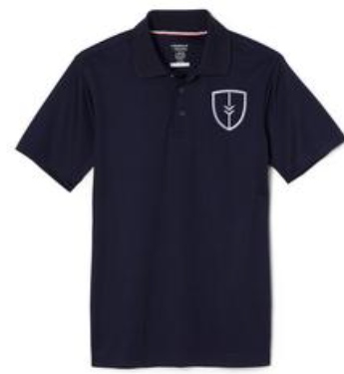
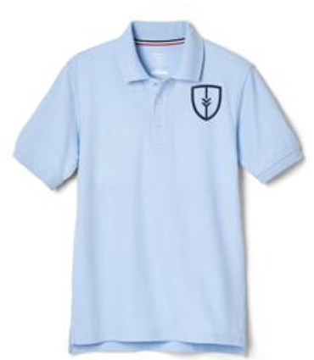
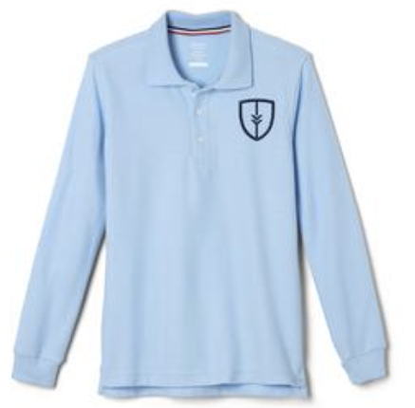
UNIFORM GUIDE
3rd - 5th GIRLS DAILY
Performance Polo Shirt
#1012 or 1629
navy or blue
Pique Polo Shirt
#1012
navy or blue
Pique Polo Shirt
#1012
navy or blue
Crewneck Sweater Cardigan
#1371 navy
V-Neck Pullover Sweater
#1731 navy
Belt
*any vendor – black
At The Knee Pleated Skirt
# 1065 clear blue plaid
Pleated Two-Tab Skort
# 1302 khaki
Pull-on Kick Pleat Performance Skort
# 1703 khaki
Girls’ Stretch Twill Bermuda Short
#1692 khaki
Girls’ Slim Fit Stretch Twill Pant
#1417 khaki
Girls’ Straight Fit Stretch Twill Pant
#1573 khaki

Slide 5
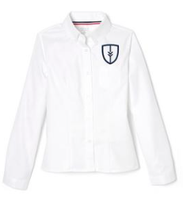
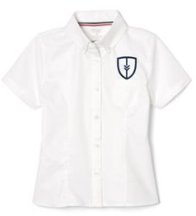

UNIFORM GUIDE
3rd - 5th GIRLS FORMAL
Belt
*any vendor - black
Crewneck Sweater Cardigan
#1371 navy
V-Neck Pullover Sweater
#1731 navy
Fitted Oxford Shirt - white
#1706 long sleeve or #1707 short sleeve
Cross Tie
#10754 clear blue plaid
#10744 navy
At The Knee Pleated Skirt
#1065 clear blue plaid
Pleated Two-Tab Skort
#1302 khaki
#1397 plaid
Pull-on Kick Pleat Performance Skort
#1703 khaki
Girls’ Stretch Twill Bermuda Short
#1692 khaki
Girls’ Straight Fit Stretch Twill Pant
#1573 khaki

Slide 6
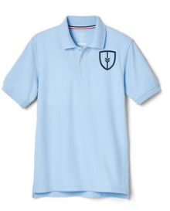
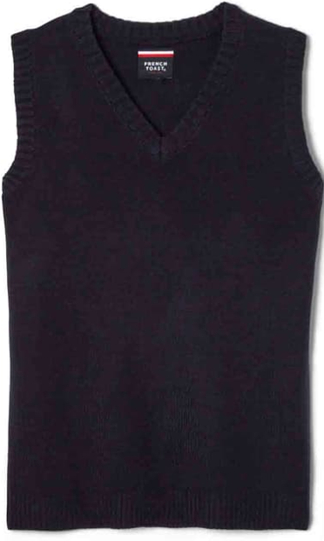

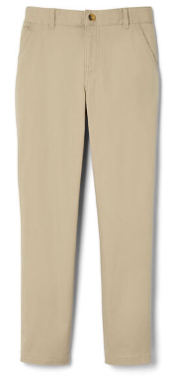
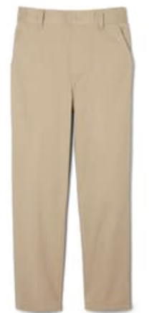
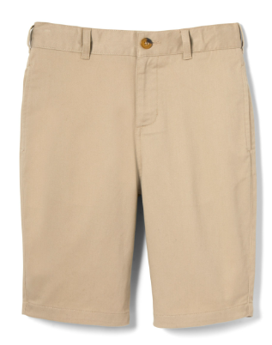
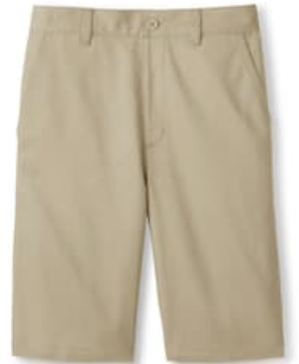
UNIFORM GUIDE
K - 5th BOYS DAILY
V-Neck Pullover Sweater
#1731 navy
V-Neck Sweater Vest
#1029 navy
Performance Polo Shirt
#1629 navy or blue
Pique Polo Shirt
#1012
navy or blue
Pique Polo Shirt
#1012
navy or blue
Belt
*any vendor – black
Boys’ Flat Front Stretch Twill Short
#1699 khaki
Girls’ Stretch Twill Bermuda Short
#1692 khaki
Boys’ Straight Fit Stretch Twill Pant
#1694 khaki
Pull-On Relaxed Fit Stretch Twill Pant
#1348 khaki

Slide 7
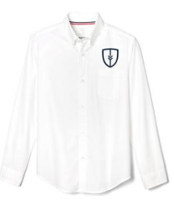
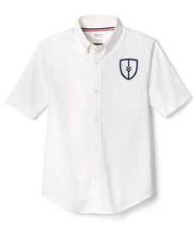

UNIFORM GUIDE
K - 5th BOYS FORMAL
V-Neck Pullover Sweater
#1731 navy
V-Neck Sweater Vest
#1029 navy
Oxford Shirt - white
#1017 long sleeve or #1020 short sleeve
Tie
#1030 clear blue plaid
#1031 navy
Boys’ Straight Fit Stretch Twill Pant
#1694 khaki
Boys’ Flat Front Stretch Twill Short
#1699 khaki
Belt
*any vendor – black

Slide 8
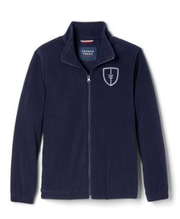
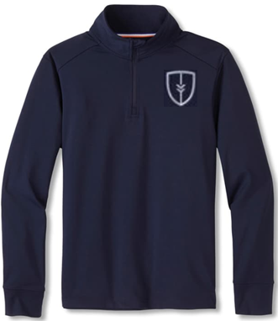
UNIFORM GUIDE
OUTERWEAR
Performance Quarter Zip Pullover
#1725 navy
Full Zip Microfleece Jacket
#1689 navy

Slide 9
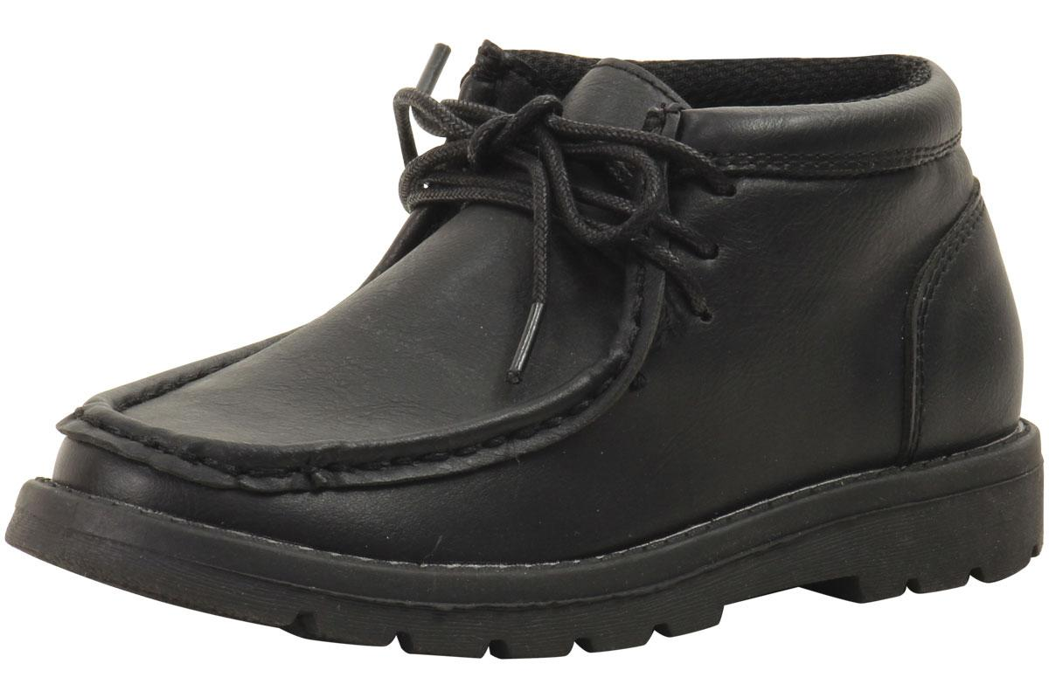
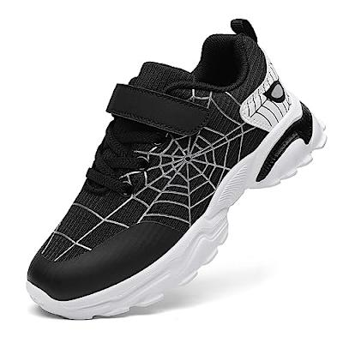
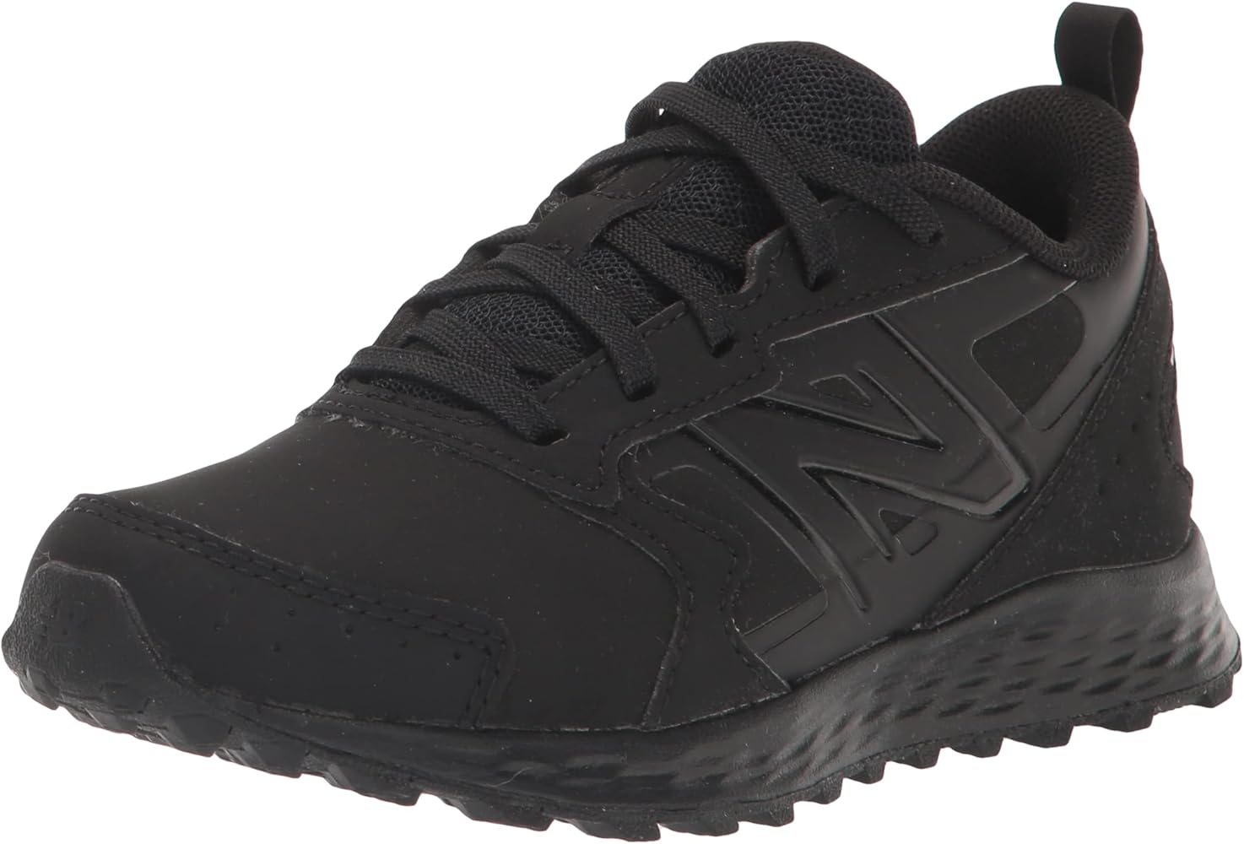
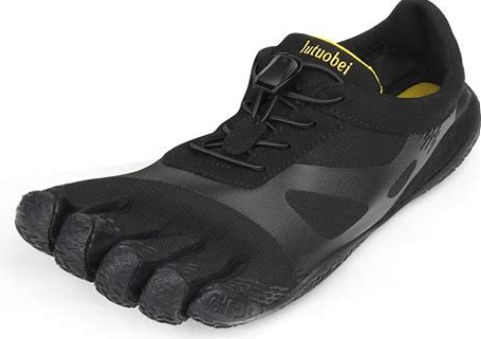
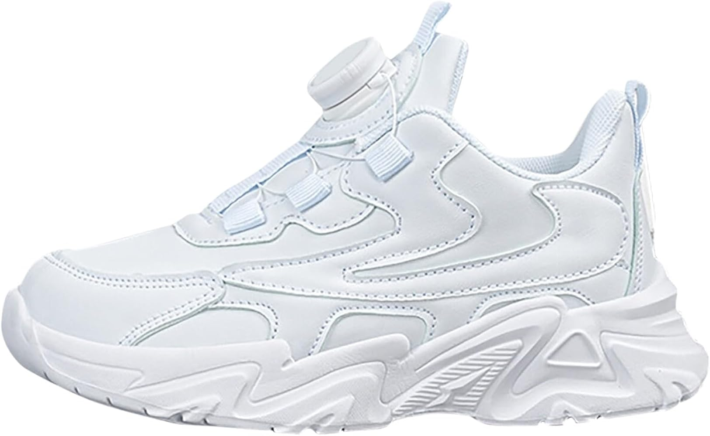
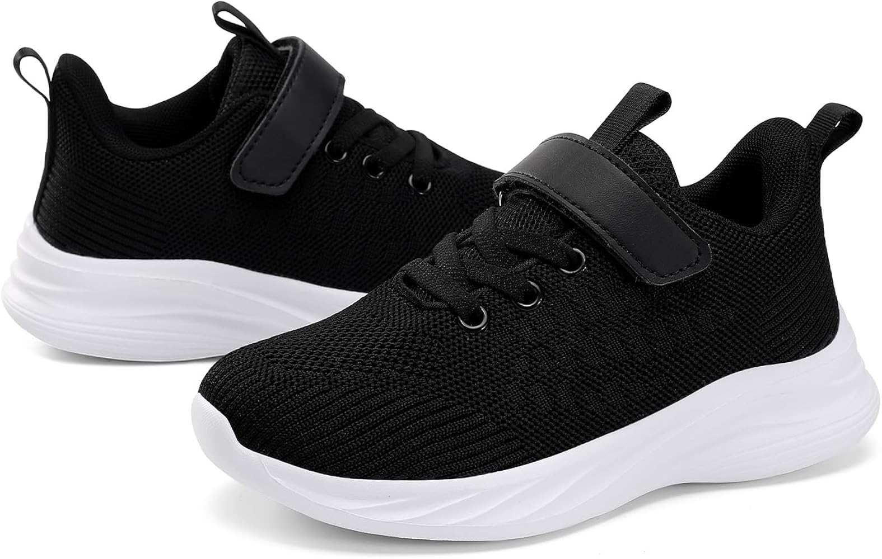
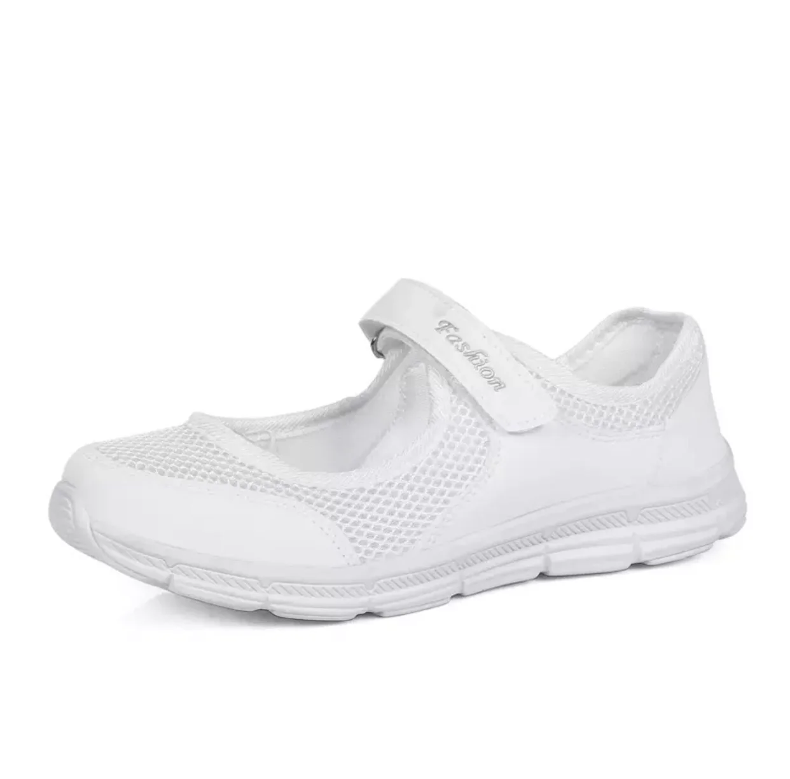
UNIFORM GUIDE
SOCKS & SHOES
K - 5th Shoes Requirements
Must be all white or all black. Athletic shoes only in grades K-5th. Any style white, black or navy socks are permitted.
Acceptable
Black & White
NOT ACCEPTABLE:
Boots, Dress shoes, or Barefoot Five-Toed shoes

Slide 10
UNIFORM GUIDE
GIRLS’ UNIFORM GUIDANCE
Uniform Guidance
6th and 7th
Additional uniform guidance may be found on pages 15-17 of the Ivy Classical Academy Family Handbook.

Slide 11
UNIFORM GUIDE
The following pages contain uniform items that are for Upper School Students only.

Slide 12
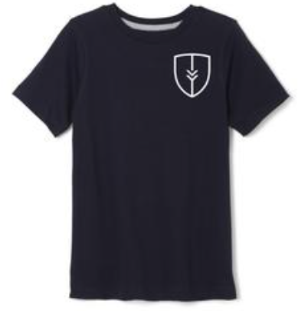
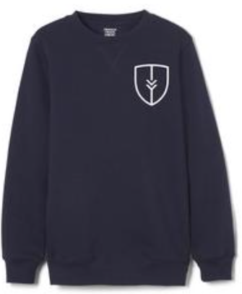
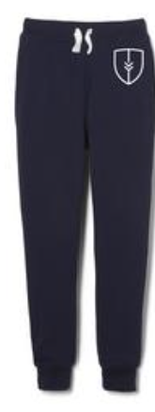
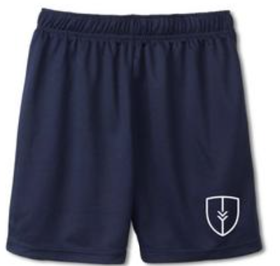
UNIFORM GUIDE PHYSICAL EDUCATION UNIFORMS
Short Sleeve Crewneck Tee
#1682 navy
Crewneck Fleece Sweatshirt
#11696 navy
Performance Mesh Shorts
#3223 navy
Fleece Jogger
#1697 navy

Slide 13
UNIFORM GUIDE
UPPER SCHOOL GIRLS DAILY
2025/2026 UNIFORM GUIDE 6th GIRLS DAILY
Belt
*any vendor – black
Performance Polo Shirt
#1629 navy or white
Pique Polo Shirt
#1012 navy or blue
Crewneck Sweater Cardigan
#1371 navy
V-Neck Pullover Sweater
#1731 navy
At The Knee Pleated Skirt
# 1065 clear blue plaid
Pleated Two-Tab Skort
#1302 khaki
#1397 plaid
Pull-on Kick Pleat Performance Skort
#1703 khaki
Girls’ Stretch Twill Bermuda Short
#1692 khaki
Girls’ Straight Fit Stretch Twill Pant
#1573 khaki

Slide 14
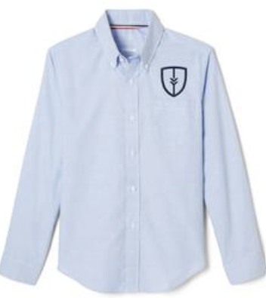
UNIFORM GUIDE
UPPER SCHOOL GIRLS FORMAL
2025/2026 UNIFORM GUIDE 6th GIRLS FORMAL
Belt
*any vendor – black
Long Sleeve Fitted Oxford Shirt
#1706 blue or white
Fitted Oxford Shirt
#1707 short sleeve
Crewneck Sweater Cardigan
#1371 navy
V-Neck Pullover Sweater
#1731 navy
Cross Tie
#10754 clear blue plaid
#10744 navy
At The Knee Pleated Skirt
# 1065 clear blue plaid
Pleated Two-Tab Skort
# 1302 khaki
Pull-on Kick Pleat Performance Skort
# 1703 khaki
Girls’ Stretch Twill Bermuda Short
#1692 khaki
Girls’ Straight Fit Stretch Twill Pant
#1573 khaki

Slide 15
UNIFORM GUIDE
UPPER SCHOOL BOYS DAILY
2025/2026 UNIFORM GUIDE
6th BOYS DAILY
Performance Polo Shirt
#1629 navy or white
Pique Polo Shirt
#1012 navy or blue
Belt
*any vendor – black
V-Neck Pullover Sweater
#1731 navy
V-Neck Sweater Vest
#1029 navy
Boys’ Flat Front Stretch Twill Short
#1699 khaki
Boys’ Straight Fit Stretch Twill Pant
#1694 khaki

Slide 16
UNIFORM GUIDE
UPPER SCHOOL BOYS DAILY
2025/2026 UNIFORM GUIDE
6th BOYS FORMAL
Long Sleeve Fitted Oxford Shirt
#1017 blue or white
Fitted Oxford Shirt
#1707 short sleeve
V-Neck Pullover Sweater
#1731 navy
V-Neck Sweater Vest
#1029 navy
Belt
*any vendor - black
Boys’ Straight Fit Stretch Twill Pant
#1694 khaki
Boys’ Flat Front Stretch Twill Short
#1699 khaki
Tie
#1030 clear blue plaid

Slide 17
UNIFORM GUIDE
SOCKS & SHOES
Upper School Shoes Requirements
Must be all white or all black. Scholars may wear dress shoes but must have athletic shoes to wear for PE.
Any style white, black or navy socks are permitted.
Acceptable
Black & White
NOT ACCEPTABLE:
Boots, Dress shoes, or Barefoot Five-Toed shoes

